Slide 1
Binary Logistic Regression with SPSS
Karl L. Wuensch
Dept of Psychology
East Carolina University

Slide 2
Download the Instructional Document
http://core.ecu.edu/psyc/wuenschk/SPSS/SPSS-MV.htm .
Click on Binary Logistic Regression .
Save to desktop.
Open the document.

Slide 3
When to Use Binary Logistic Regression
The criterion variable is dichotomous.
Predictor variables may be categorical or continuous.
If predictors are all continuous and nicely distributed, may use discriminant function analysis.
If predictors are all categorical, may use logit analysis.

Slide 4
Wuensch & Poteat, 1998
Cats being used as research subjects.
Stereotaxic surgery.
Subjects pretend they are on university research committee.
Complaint filed by animal rights group.
Vote to stop or continue the research.

Slide 5
Purpose of the Research
Cosmetic
Theory Testing
Meat Production
Veterinary
Medical

Slide 6
Predictor Variables
Gender
Ethical Idealism (9-point Likert)
Ethical Relativism (9-point Likert)
Purpose of the Research

Slide 7
Model 1: Decision = Gender
Decision 0 = stop, 1 = continue
Gender 0 = female, 1 = male
Model is ….. logit =
is the predicted probability of the event which is coded with 1 (continue the research) rather than with 0 (stop the research).

Slide 8
Iterative Maximum Likelihood Procedure
SPSS starts with arbitrary regression coefficents.
Tinkers with the regression coefficients to find those which best reduce error.
Converges on final model.

Slide 9
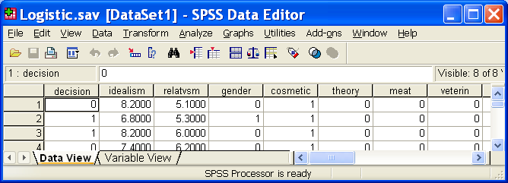
SPSS
Bring the data into SPSS
http://core.ecu.edu/psyc/wuenschk/SPSS/Logistic.sav
Analyze, Regression, Binary Logistic

Slide 10
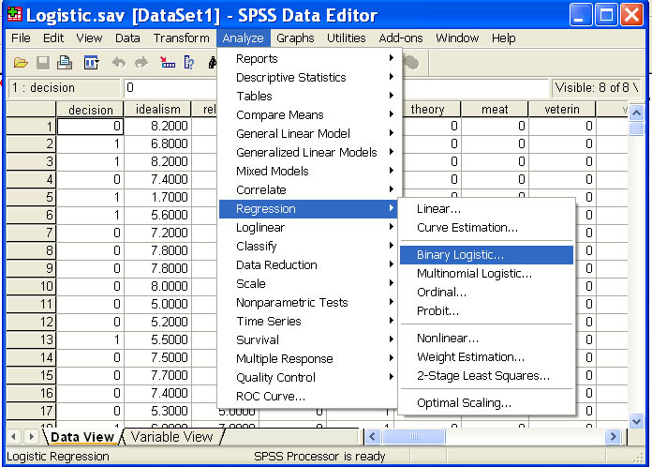

Slide 11
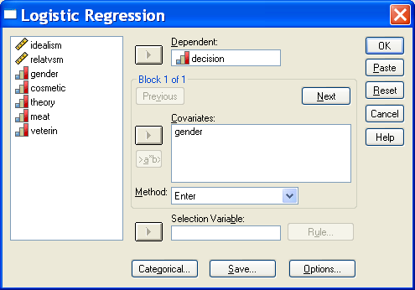
Decision → Dependent
Gender → Covariate(s), OK

Slide 12
Look at the Output
We have 315 cases.

Slide 13
Block 0 Model, Odds
Look at Variables in the Equation.
The model contains only the intercept (constant, B₀), a function of the marginal distribution of the decisions.

Slide 14
Exponentiate Both Sides
Exponentiate both sides of the equation:
e^{-.379} = .684 = Exp(B₀) = odds of deciding to continue the research.
128 voted to continue the research, 187 to stop it.

Slide 15
Probabilities
Randomly select one participant.
P(votes continue) = 128/315 = 40.6%
P(votes stop) = 187/315 = 59.4%
Odds = 40.6/59.4 = .684
Repeatedly sample one participant and guess how e will vote.

Slide 16
Humans vs. Goldfish
Humans Match Probabilities
(suppose p = .7, q = .3)
.7(.7) + .3(.3) = .49 + .09 = .58
Goldfish Maximize Probabilities
.7(1) = .70
The goldfish win!

Slide 17

SPSS Model 0 vs. Goldfish
Look at the Classification Table for Block 0.
SPSS Predicts “STOP” for every participant.
SPSS is as smart as a Goldfish here.

Slide 18
Block 1 Model
Gender has now been added to the model.
Model Summary: -2 Log Likelihood = how poorly model fits the data.

Slide 19
Block 1 Model
For intercept only, -2LL = 425.666.
Add gender and -2LL = 399.913.
Omnibus Tests: Drop in -2LL = 25.653 = Model χ².
df = 1, p < .001.

Slide 20
Variables in the Equation
ln(odds) = -.847 + 1.217∗Gender

Slide 21
Odds, Women
A woman is only .429 as likely to decide to continue the research as she is to decide to stop it.

Slide 22
Odds, Men
A man is 1.448 times more likely to vote to continue the research than to stop the research.

Slide 23
Odds Ratio
1.217 was the B (slope) for Gender, 3.376 is the Exp(B), that is, the exponentiated slope, the odds ratio.
Men are 3.376 times more likely to vote to continue the research than are women.

Slide 24
Convert Odds to Probabilities
For our women,
For our men,

Slide 25
Classification
Decision Rule: If Prob (event) ≥ Cutoff, then predict event will take place.
By default, SPSS uses .5 as Cutoff.
For every man, Prob(continue) = .59, predict he will vote to continue.
For every woman Prob(continue) = .30, predict she will vote to stop it.

Slide 26
Overall Success Rate
Look at the Classification Table
SPSS beat the Goldfish!

Slide 27
Sensitivity
P (correct prediction | event did occur)
P (predict Continue | subject voted to Continue)
Of all those who voted to continue the research, for how many did we correctly predict that.

Slide 28
Specificity
P (correct prediction | event did not occur)
P (predict Stop | subject voted to Stop)
Of all those who voted to stop the research, for how many did we correctly predict that.

Slide 29
False Positive Rate
P (incorrect prediction | predicted occurrence)
P (subject voted to Stop | we predicted Continue)
Of all those for whom we predicted a vote to Continue the research, how often were we wrong.

Slide 30
False Negative Rate
P (incorrect prediction | predicted nonoccurrence)
P (subject voted to Continue | we predicted Stop)
Of all those for whom we predicted a vote to Stop the research, how often were we wrong.

Slide 31
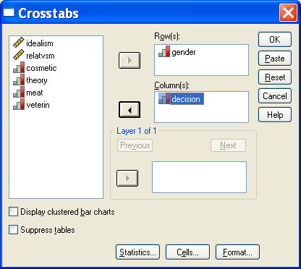
Pearson χ²
Analyze, Descriptive Statistics, Crosstabs
Gender → Rows; Decision → Columns

Slide 32

Crosstabs Statistics
Statistics, Chi-Square, Continue

Slide 33
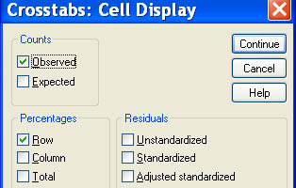
Crosstabs Cells
Cells, Observed Counts, Row Percentages

Slide 34
Crosstabs Output
Continue, OK
59% & 30% match logistic’s predictions.

Slide 35
Crosstabs Output
Likelihood Ratio χ² = 25.653, as with logistic.

Slide 36
Model 2: Decision = Idealism, Relativism, Gender
Analyze, Regression, Binary Logistic
Decision → Dependent
Gender, Idealism, Relatvsm→ Covariate(s)

Slide 37
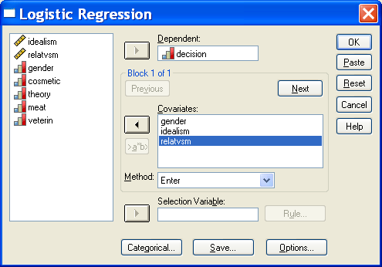

Slide 38
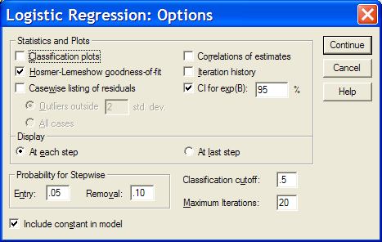
Click Options and check “Hosmer-Lemeshow goodness of fit” and “CI for exp(B) 95%.”
Continue, OK.

Slide 39
Comparing Nested Models
With only intercept and gender, -2LL = 399.913.
Adding idealism and relativism dropped -2LL to 346.503, a drop of 53.41.
χ²(2) = 399.913 – 346.503 = 53.41, p = ?

Slide 40
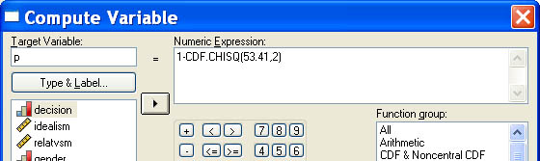
Obtain p
Transform, Compute
Target Variable = p
Numeric Expression = 1 - CDF.CHISQ(53.41,2)

Slide 41
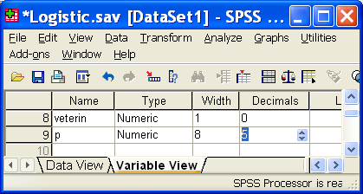
p = ?
OK
Data Editor, Variable View
Set Decimal Points to 5 for p

Slide 42
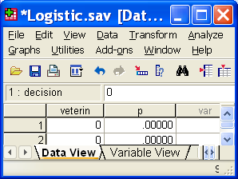
p < .0001
Data Editor, Data View
p = .00000
Adding the ethical ideology variables significantly improved the model.

Slide 43
Hosmer-Lemeshow
H_{ø}: predictions made by the model fit perfectly with observed group memberships
Cases are arranged in order by their predicted probability on the criterion.
Then divided into (usually) ten bins with approximately equal n.
This gives ten rows in the table.

Slide 44
For each bin and each event, we have number of observed cases and expected number predicted from the model.

Slide 45
Note expected freqs decline in first column, rise in second.
The nonsignificant chi-square is indicative of good fit of data with linear model.

Slide 46
Hosmer-Lemeshow
There are problems with this procedure.
Hosmer and Lemeshow have acknowledged this.
Even with good fit the test may be significant if sample sizes are large
Even with poor fit the test may not be significant if sample sizes are small.
Number of bins can have a big effect on the results of this test.

Slide 47
Linearity of the Logit
We have assumed that the log odds are related to the predictors in a linear fashion.
Use the Box-Tidwell test to evaluate this assumption.
For each continuous predictor, compute the natural log.
Include in the model interactions between each predictor and its natural log.

Slide 48
Box-Tidwell
If an interaction is significant, there is a problem.
For the troublesome predictor, try including the square of that predictor.
That is, add a polynomial component to the model.
See T-Test versus Binary Logistic Regression

Slide 49
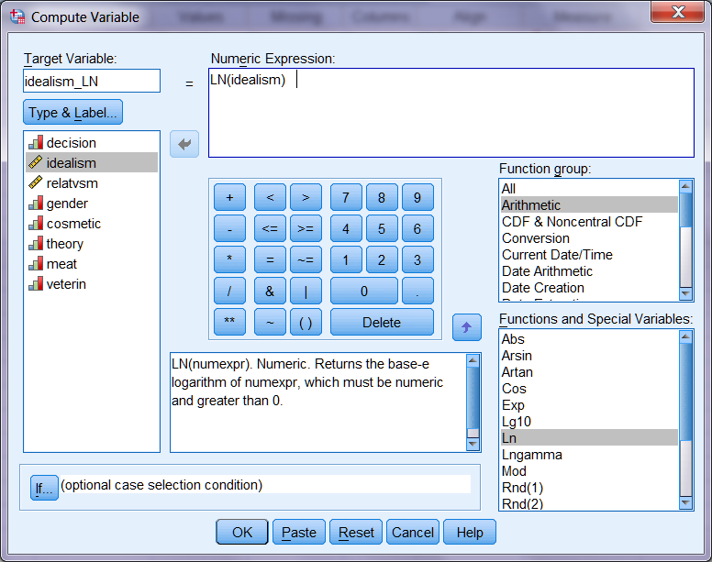

Slide 50
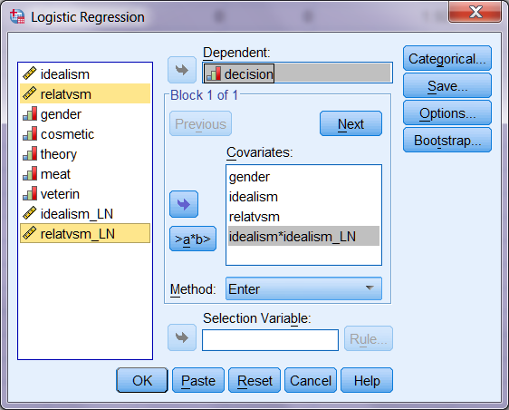

Slide 51
Variables in the Equation
 |  | B | S.E. | Wald | df | Sig. | Exp(B)
Step 1ª | gender | 1.147 | .269 | 18.129 | 1 | .000 | 3.148
 | idealism | 1.130 | 1.921 | .346 | 1 | .556 | 3.097
 | relatvsm | 1.656 | 2.637 | .394 | 1 | .530 | 5.240
 | idealism by idealism_LN | -.652 | .690 | .893 | 1 | .345 | .521
 | relatvsm by relatvsm_LN | -.479 | .949 | .254 | 1 | .614 | .620
 | Constant | -5.015 | 5.877 | .728 | 1 | .393 | .007
a. Variable(s) entered on step 1: gender, idealism, relatvsm, idealism * idealism_LN , relatvsm * relatvsm_LN .
No Problem Here.

Slide 52
Model 3: Decision = Idealism, Relativism, Gender, Purpose
Need 4 dummy variables to code the five purposes.
Consider the Medical group a reference group.
Dummy variables are: Cosmetic, Theory, Meat, Veterin.
0 = not in this group, 1 = in this group.

Slide 53
Add the Dummy Variables
Analyze, Regression, Binary Logistic
Add to the Covariates: Cosmetic, Theory, Meat, Veterin.
OK

Slide 54
Block 0
Look at “Variables not in the Equation.”
“Score” is how much -2LL would drop if a single variable were added to the model with intercept only.

Slide 55
Effect of Adding Purpose
Our previous model had -2LL = 346.503.
Adding Purpose dropped -2LL to 338.060.
χ²(4) = 8.443, p = .0766.
But I make planned comparisons (with medical reference group) anyhow!

Slide 56
Classification Table
YOU calculate the sensitivity, specificity, false positive rate, and false negative rate.

Slide 57
Answer Key
Sensitivity = 74/128 = 58%
Specificity = 152/187 = 81%
False Positive Rate = 35/109 = 32%
False Negative Rate = 54/206 = 26%

Slide 58
Wald Chi-Square
A conservative test of the unique contribution of each predictor.
Presented in Variables in the Equation.
Alternative: drop one predictor from the model, observe the increase in -2LL, test via χ².

Slide 60
Odds Ratios – Exp(B)
Odds of approval more than cut in half (.496) for each one point increase in Idealism.
Odds of approval multiplied by 1.39 for each one point increase in Relativism.
Odds of approval if purpose is Theory Testing are only .314 what they are for Medical Research.
Odds of approval if purpose is Agricultural Research are only .421 what they are for Medical research

Slide 61
Inverted Odds Ratios
Some folks have problems with odds ratios less than 1.
Just invert the odds ratio.
For example, 1/.421 = 2.38.
That is, respondents were more than two times more likely to approve the medical research than the research designed to feed the poor in the third world.

Slide 62
Classification Decision Rule
Consider a screening test for Cancer.
Which is the more serious error
False Positive – test says you have cancer, but you do not
False Negative – test says you do not have cancer but you do
Want to reduce the False Negative rate?

Slide 63
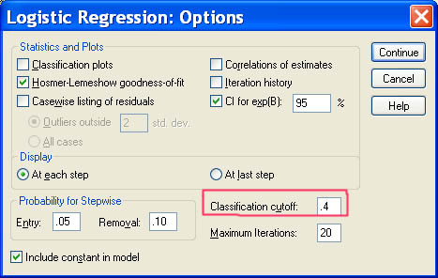
Classification Decision Rule
Analyze, Regression, Binary Logistic
Options
Classification Cutoff = .4, Continue, OK

Slide 64
Effect of Lowering Cutoff
YOU calculate the Sensitivity, Specificity, False Positive Rate, and False Negative Rate for the model with the cutoff at .4.
Fill in the table on page 15 of the handout.

Slide 65
Answer Key

Slide 66

SAS Rules
See, on page 16 of the handout, how easy SAS makes it to see the effect of changing the cutoff.
SAS classification tables remove bias (using a jackknifed classification procedure), SPSS does not have this feature.

Slide 67
Presenting the Results
See the handout.

Slide 68
Interaction Terms
May want to standardize continuous predictor variables.
Compute the interaction terms or
Let Logistic compute them.

Slide 69
Deliberation and Physical Attractiveness in a Mock Trial
Subjects are mock jurors in a criminal trial.
For half the defendant is plain, for the other half physically attractive.
Half recommend a verdict with no deliberation, half deliberate first.

Slide 70
Get the Data
Bring Logistic2x2x2.sav into SPSS.
Each row is one cell in 2x2x2 contingency table.
Could do a logit analysis, but will do logistic regression instead.

Slide 71
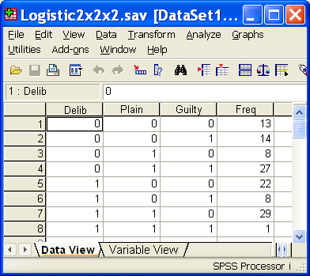

Slide 72
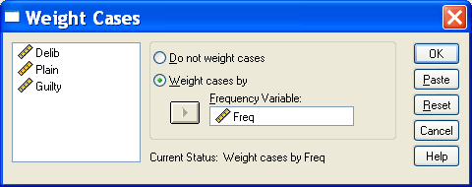
Tell SPSS to weight cases by Freq. Data, Weight Cases:

Slide 73
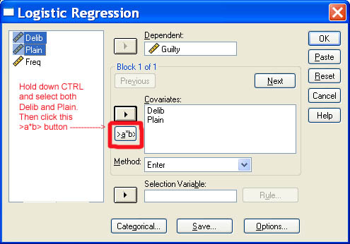
Dependent = Guilty.
Covariates = Delib, Plain.
In left pane highlight Delib and Plain.

Slide 74
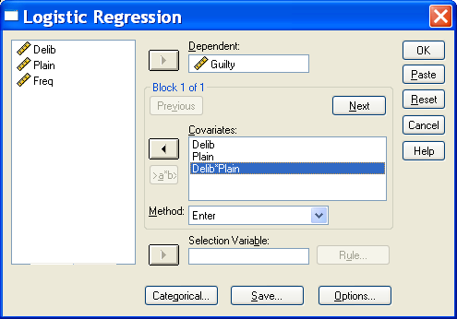
Then click >a*b> to create the interaction term.

Slide 75
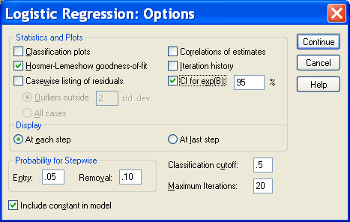
Under Options, ask for the Hosmer-Lemeshow test and confidence intervals on the odds ratios.

Slide 76
Significant Interaction
The interaction is large and significant (odds ratio of .030), so we shall ignore the main effects.

Slide 77
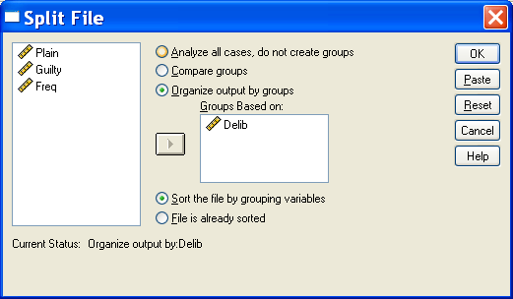
Use Crosstabs to test the conditional effects of Plain at each level of Delib.
Split file by Delib.

Slide 78
Analyze, Crosstabs.
Rows = Plain, Columns = Guilty.
Statistics, Chi-square, Continue.
Cells, Observed Counts and Column Percentages.
Continue, OK.

Slide 79
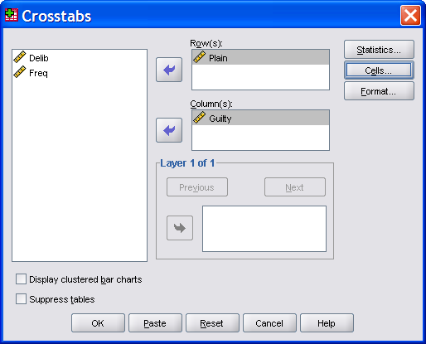
Rows = Plain, Columns = Guilty

Slide 80
For those who did deliberate, the odds of a guilty verdict are 1/29 when the defendant was plain and 8/22 when she was attractive, yielding a conditional odds ratio of 0.09483 .

Slide 81
For those who did not deliberate, the odds of a guilty verdict are 27/8 when the defendant was plain and 14/13 when she was attractive, yielding a conditional odds ratio of 3.1339.

Slide 82
Interaction Odds Ratio
The interaction odds ratio is simply the ratio of these conditional odds ratios – that is, .09483/3.1339 = 0.030.
Among those who did not deliberate, the plain defendant was found guilty significantly more often than the attractive defendant, χ²(1, N = 62) = 4.353, p = .037.
Among those who did deliberate, the attractive defendant was found guilty significantly more often than the plain defendant, χ²(1, N = 60) = 6.405, p = .011.

Slide 83
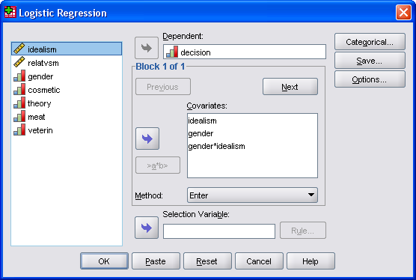
Interaction Between Continuous and Dichotomous Predictor

Slide 84
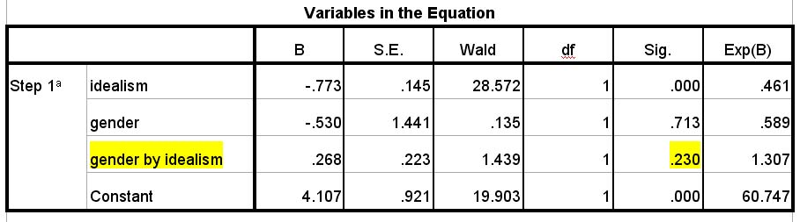
Interaction Falls Short of Significance

Slide 85
Standardizing Predictors
Most helpful with continuous predictors.
Especially when want to compare the relative contributions of predictors in the model.
Also useful when the predictor is measured in units that are not intrinsically meaningful.

Slide 86
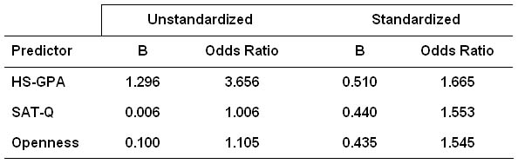
Predicting Retention in ECU’s Engineering Program

Slide 87
Practice Your New Skills
Try the exercises in the handout.

